Slide 1
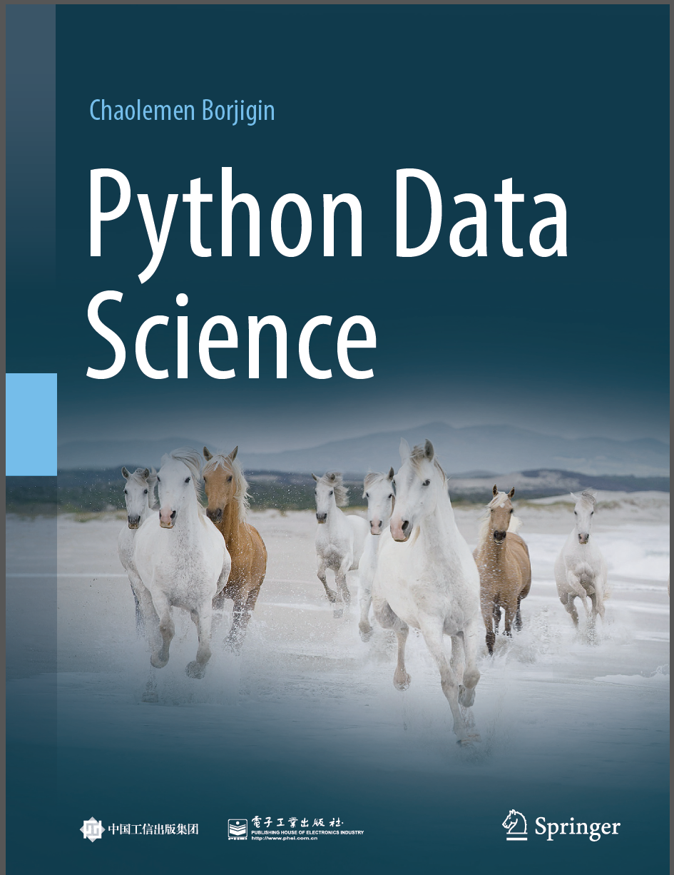
Python Data Science
Chaolemen Borjigin
Renmin University of China
chaolemen@ruc.edu.cn

Slide 2
3.7 Search path
▼ Chapter 3 Advanced Python Programming for Data Science
► 3.7 Search path
Chaolemen Borjigin
Renmin University of China
chaolemen@ruc.edu.cn

Slide 3
Summary of this chapter
▼ Chapter 3 Advanced Python Programming for Data Science
► 3.7 Search path
3.7.1 The variable search path
3.7.2 The module search path

Slide 4
3.7.1 The variable search path
▼Chapter 3 Advanced Python Programming for Data Science
► 3.7 Search path
In[1]:
dir()
Out[1]:
['In',
'Out',
'_',
'__',
……
'exit',
'get_ipython',
'quit']
In[2]:
vi=1

Slide 5
3.7.1 The variable search path
▼Chapter 3 Advanced Python Programming for Data Science
► 3.7 Search path
In[3]:
dir()
['In',
'Out',
'_',
'_1',
……
'exit',
'get_ipython',
'quit',
'vi']
Out[3]:

Slide 6
3.7.1 The variable search path
▼Chapter 3 Advanced Python Programming for Data Science
► 3.7 Search path
In[4]:
del vi
In[5]:
vi
---------------------------------------------------------------------------
NameError Traceback (most recent call last)
<ipython-input-5-cf2c6cd2c98b> in <module>()
----> 1 vi
NameError: name 'vi' is not defined

Slide 7
3.7.2 The module search path
▼Chapter 3 Advanced Python Programming for Data Science
► 3.7 Search path
In[6]:
import sys
sys.path
['',
'C:\\Anaconda\\python36.zip',
'C:\\Anaconda\\DLLs',
'C:\\Anaconda\\lib',
'C:\\Anaconda',
'C:\\Anaconda\\lib\\site-packages',
……
'C:\\Anaconda\\lib\\site-packages\\IPython\\extensions',
'C:\\Users\\soloman\\.ipython']
Out[6]:

Slide 8
3.7.2 The module search path
▼Chapter 3 Advanced Python Programming for Data Science
► 3.7 Search path
In[7]:
import sys
sys.path.append('H:\\Python\\Anaconda')
In[8]:
sys.path
['',
'C:\\Anaconda\\python36.zip',
'C:\\Anaconda\\DLLs',
……
'C:\\Anaconda\\lib\\site-packages\\IPython\\extensions',
'C:\\Users\\soloman\\.ipython',
'H:\\Python\\Anaconda']
Out[8]:

Slide 9
3.7.2 The module search path
▼Chapter 3 Advanced Python Programming for Data Science
► 3.7 Search path
In[9]:
sys.path.remove('H:\\Python\\Anaconda')
In[10]:
sys.path
['',
'C:\\Anaconda\\python36.zip',
'C:\\Anaconda\\DLLs',
……
'C:\\Anaconda\\lib\\site-packages\\Pythonwin',
'C:\\Anaconda\\lib\\site-packages\\IPython\\extensions',
'C:\\Users\\soloman\\.ipython']
Out[10]:

Slide 10


